Slide 1

Fertig
Car Sharing? Volvo.
START HACK 2019
ST.GALLEN, THE DAY CAR SHARING BECAME VOLVO 2019

Slide 2
Fertig
Google for Search Engines
Volvo for Car Sharing

Slide 3
Fertig
THE PERFECT MARKET.
UMPA.
NUDGING.

Slide 4




INTRODUCTION
Who stands before you today?
Fertig
Tetyana Drobot
Eugenia Collovà
Julian Leopold
Sebastian Kuhn

Slide 5
INTRODUCTION
Agenda
Fertig
FIRST | PROBLEM
SECOND | SOLUTION
THIRD | WHY IT WORKS
FOURTH | OUTLOOK
FIRTH | Engageability & DataLab | 20 MIN
 | Weiteres verfahren mit dem Projekt

Slide 6
FIRST
PROBLEMS

Slide 7



PARKING…
in the City

Slide 8

OWNING A CAR…
In The City

Slide 9
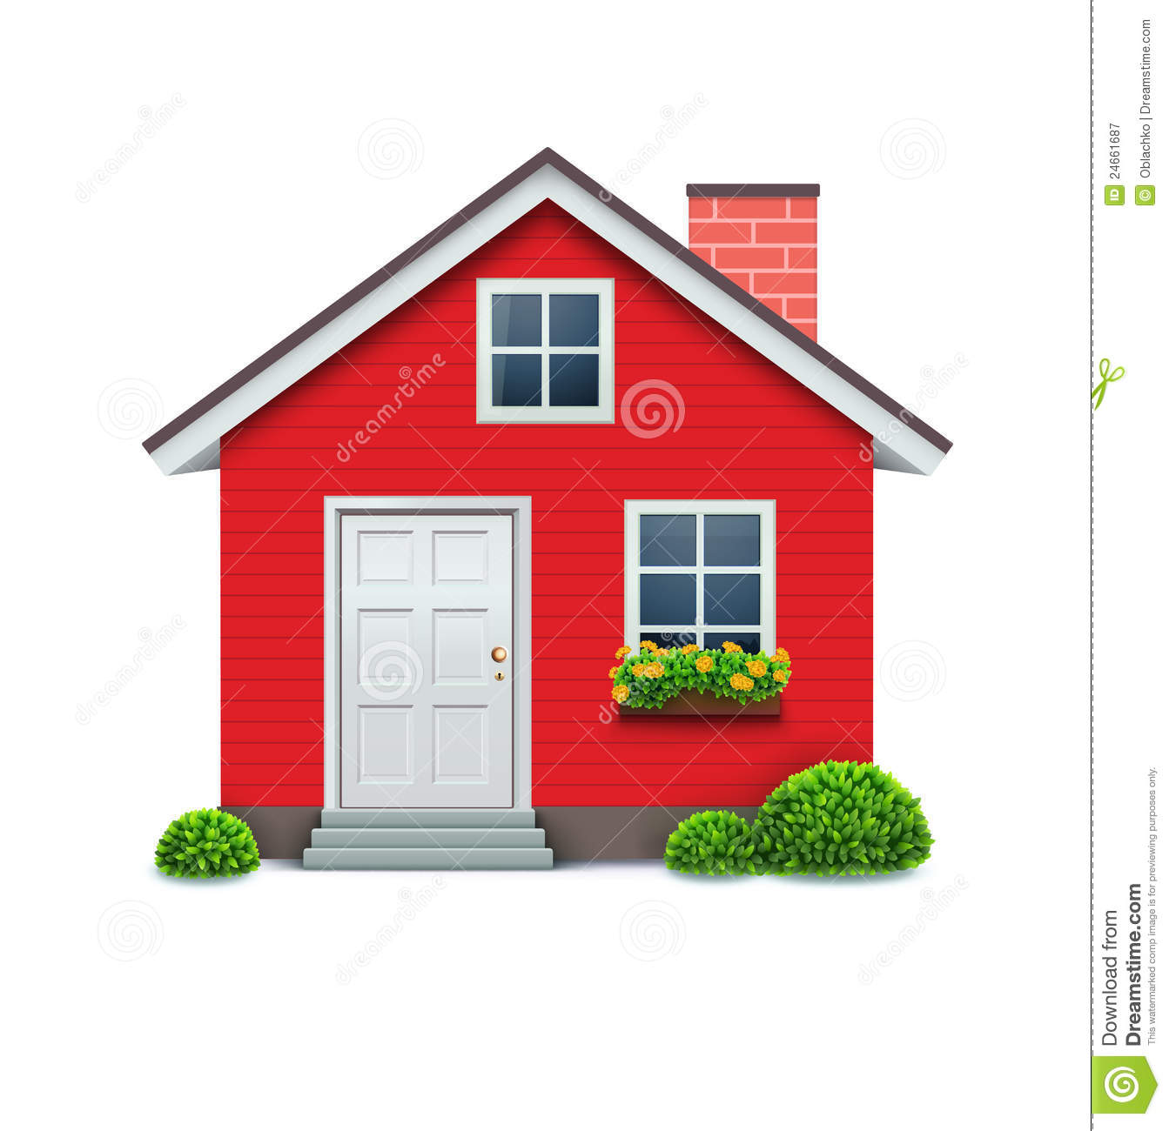

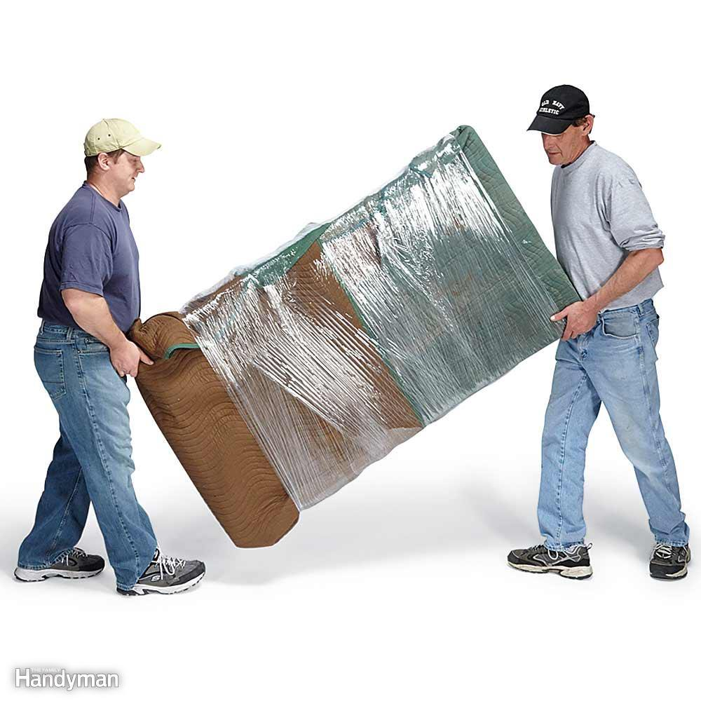
NEEDING A CAR…
In The City

Slide 10
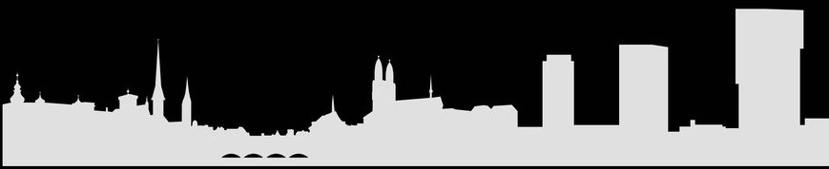
SOLUTION

Slide 11
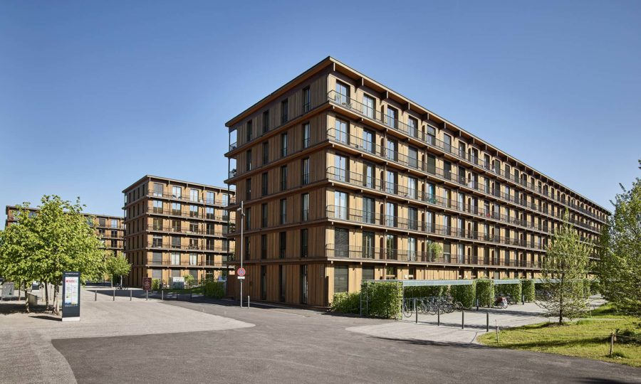
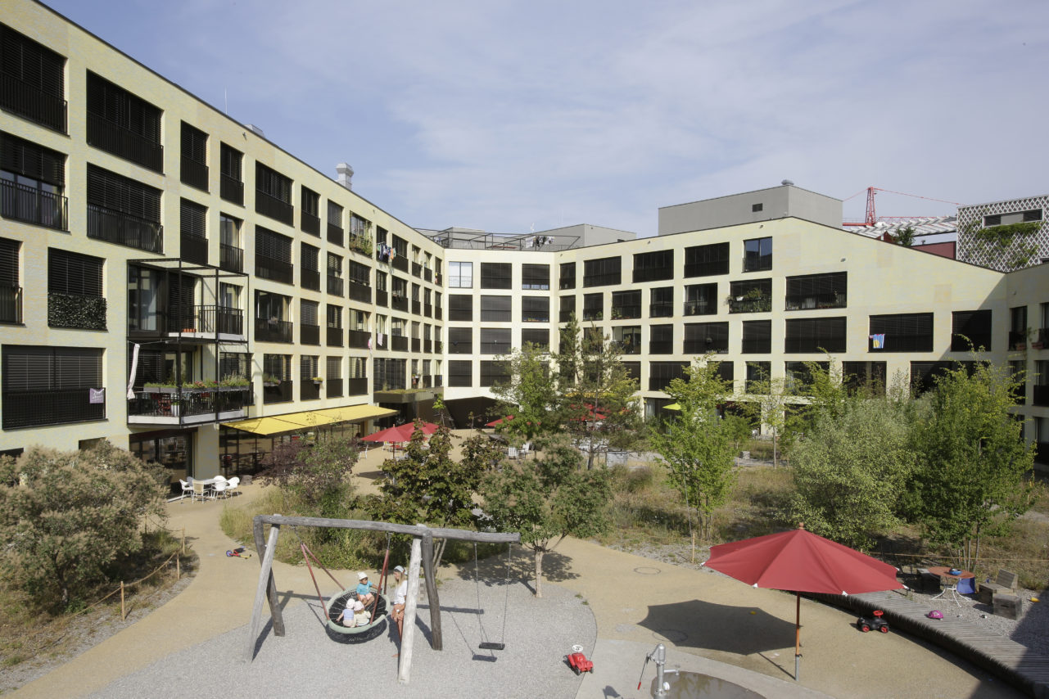
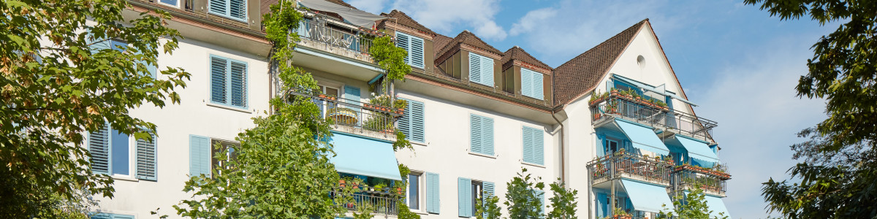
Car Sharing in…. (a safe playground)
WOHN-GENOSSENSCHAFTEN
in Zürich
20% der Mietwohnungen in Wohngenossenschaften
Freilager
Kalkbreite
Hofgarten

Slide 12




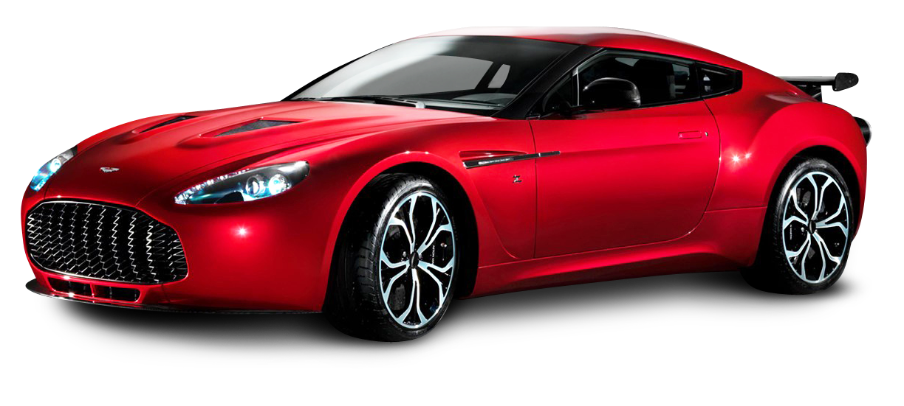
ASSUMPTIONS & Model
- App is maintained by Volvo
- Cars are owned by Volvo and rented to a network of property managers
- Clients are the flat inhabitants (Zurich based, Yuppies, Students)
Cost Structure:
Volvo (1) Property Managers(178) Clients (min 12000 Fam) Own Car Production/Maintanance Renting Costs/infrastructure Usage Costs CHF 10’363 Renting Income Operational Income (next slide) (OP: 35’000, MPA:15’000) Accounting Profits!!

Slide 13
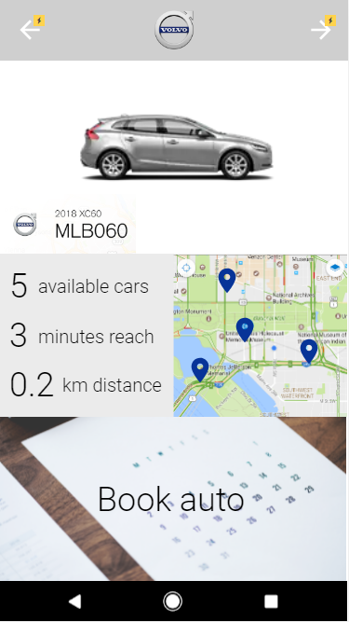
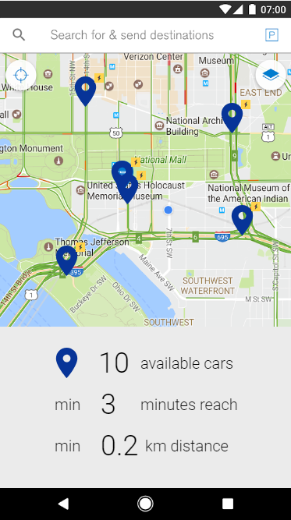
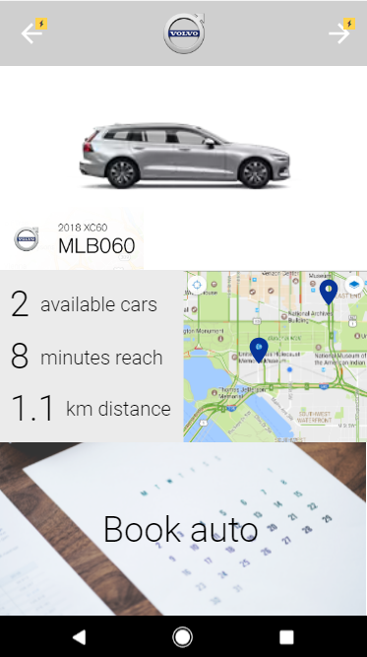
App-Booking

Slide 14

UMPA
USAGE MAXIMIZING PRICE ALLOCATION
THREE Components
def usage_price(
base_rate(starting_point, end_point, pickup_time, trip_type, car_type, ...),
location_tier_premium(starting_point, end_point),
activity_discount(
expected_request_number(pickup_time))
)
Your Current Trip
Base CHF 10
Tiers CHF 6.50
Activity CHF 5
TOTAL COST 7.50

Slide 15
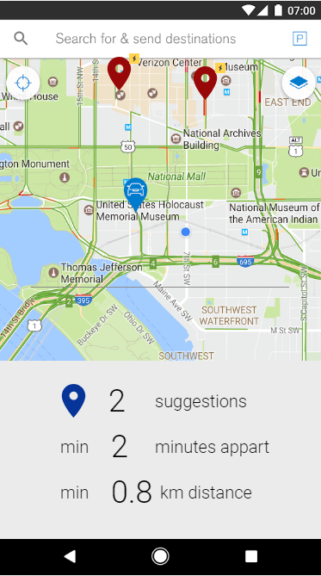
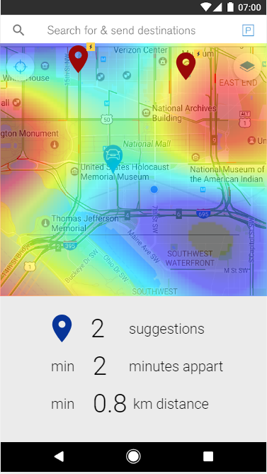
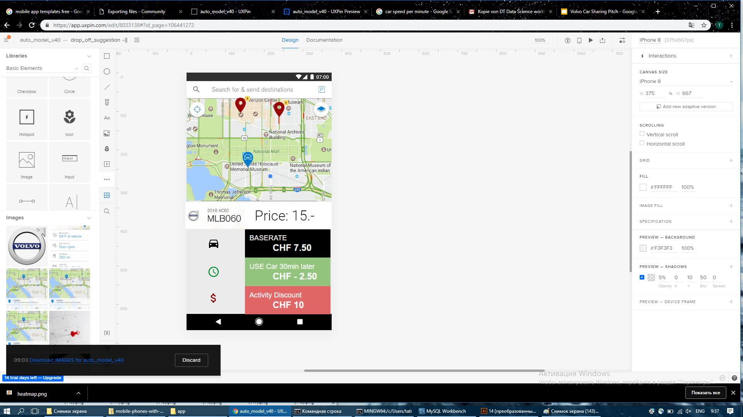
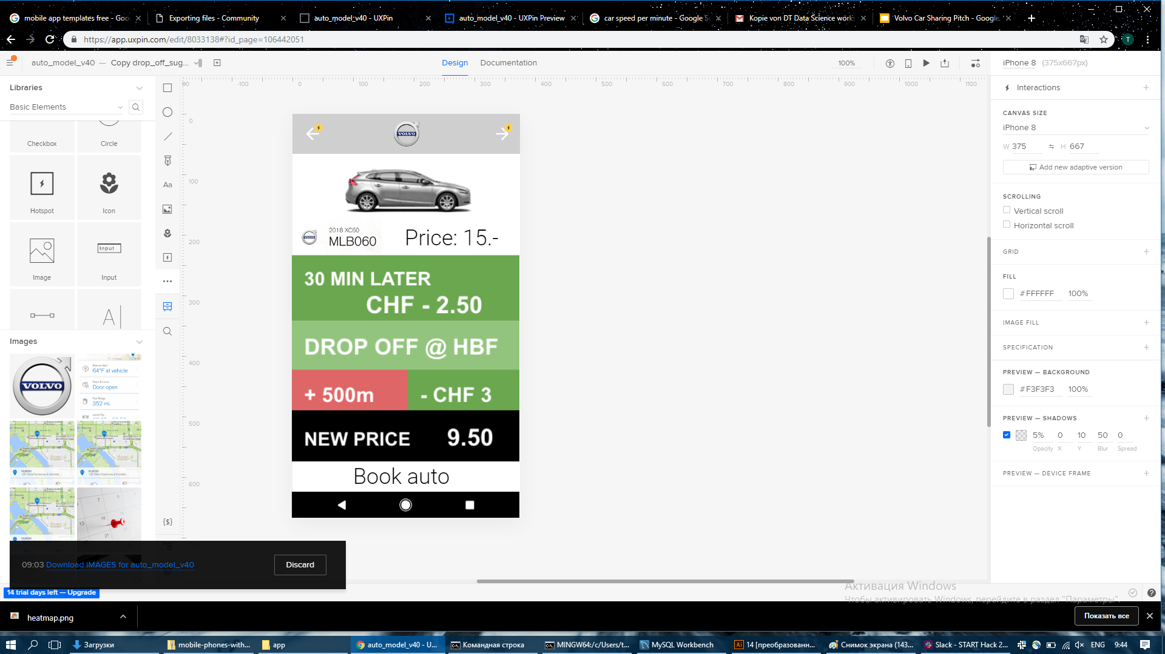
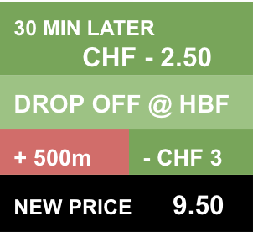
APP-Pricing

Slide 16
NUDGING
Incentivise users to bring the car to the next client
Notes:
Write down how users can improve the price
go to different location
different time

Slide 17

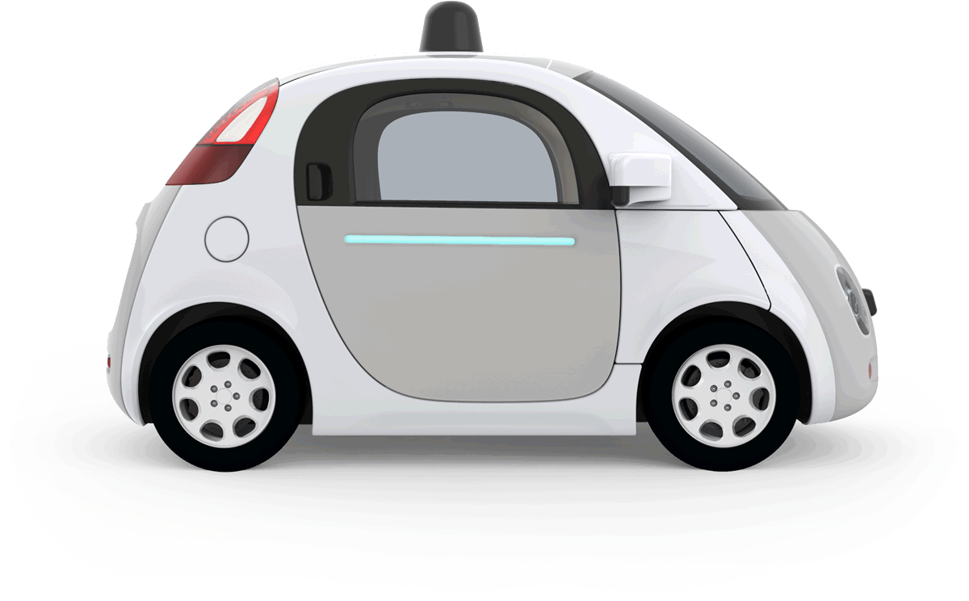
OUTLOOK
BRACE YOURSELVES SELF-DRIVING CARS ARE COMING
A new model of car ownership is upon us.
BE READY

Slide 18
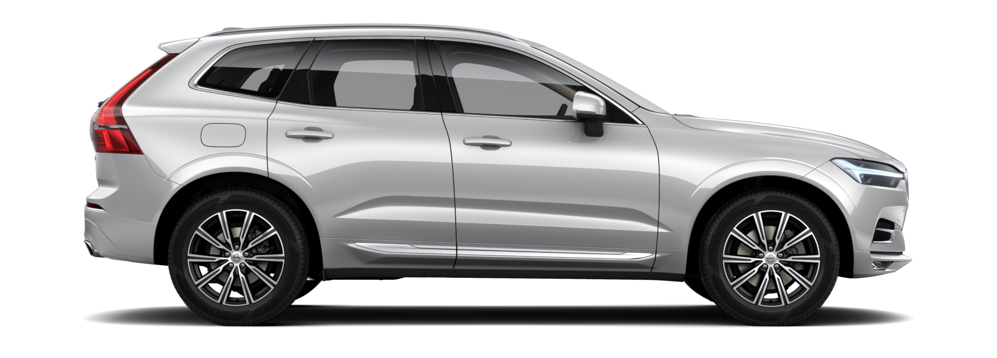
Thank You
GET A
GO PLACES

Slide 19
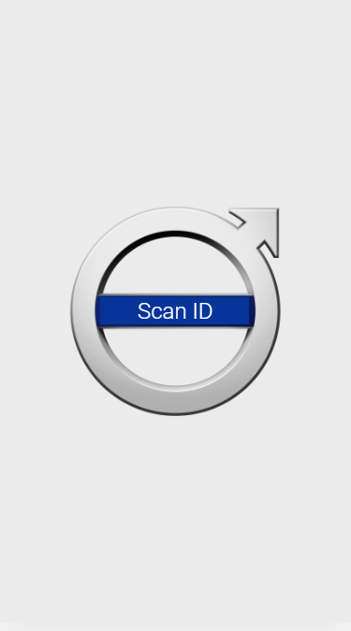

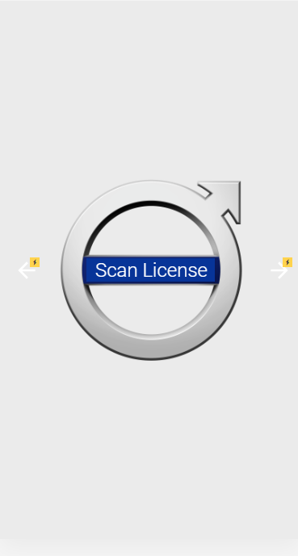
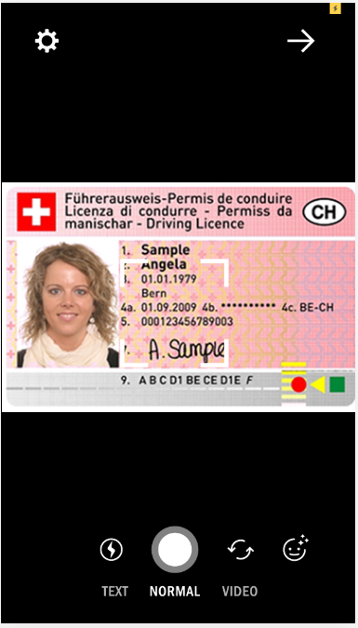
App-Registration

Slide 20
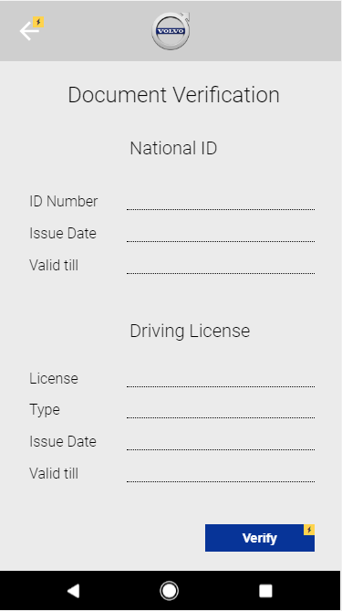
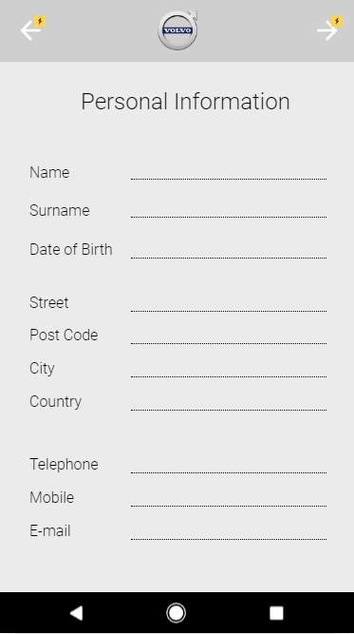
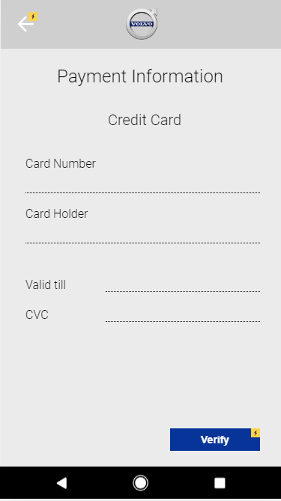
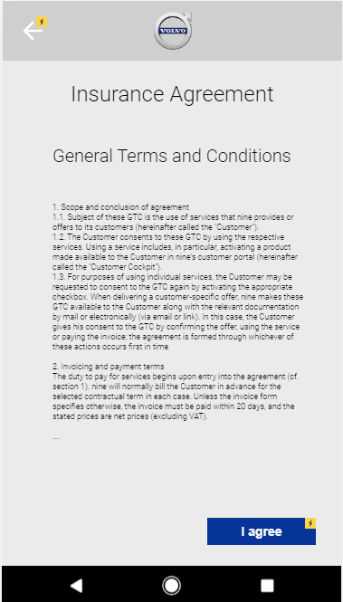
App-Forms

Slide 21
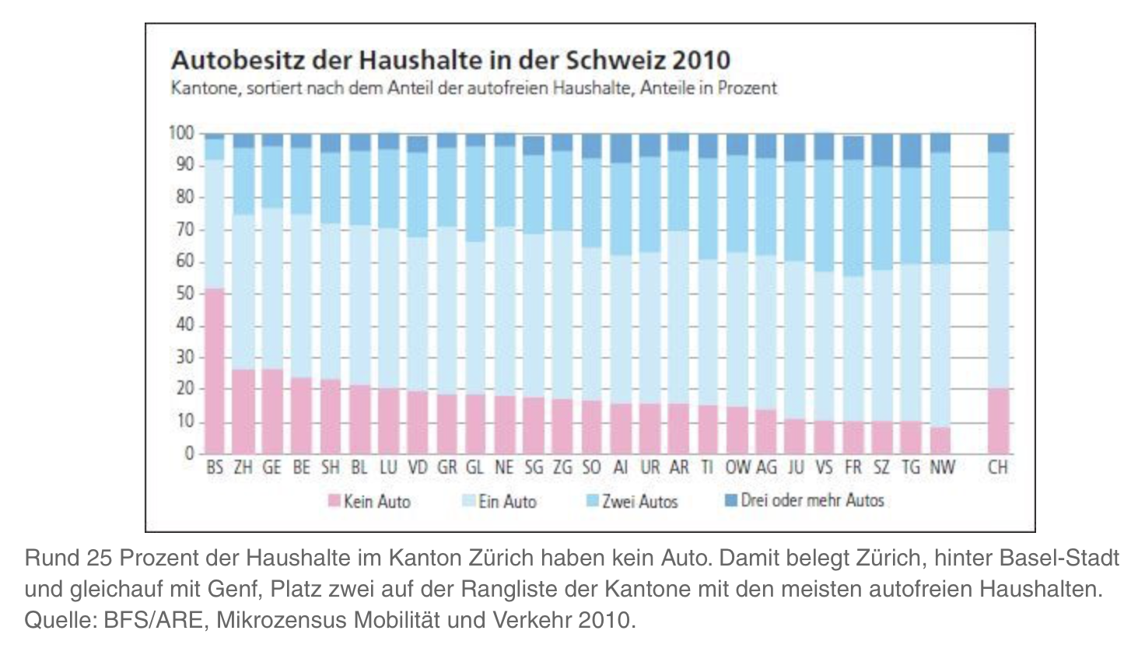
Additional Infos

Slide 22
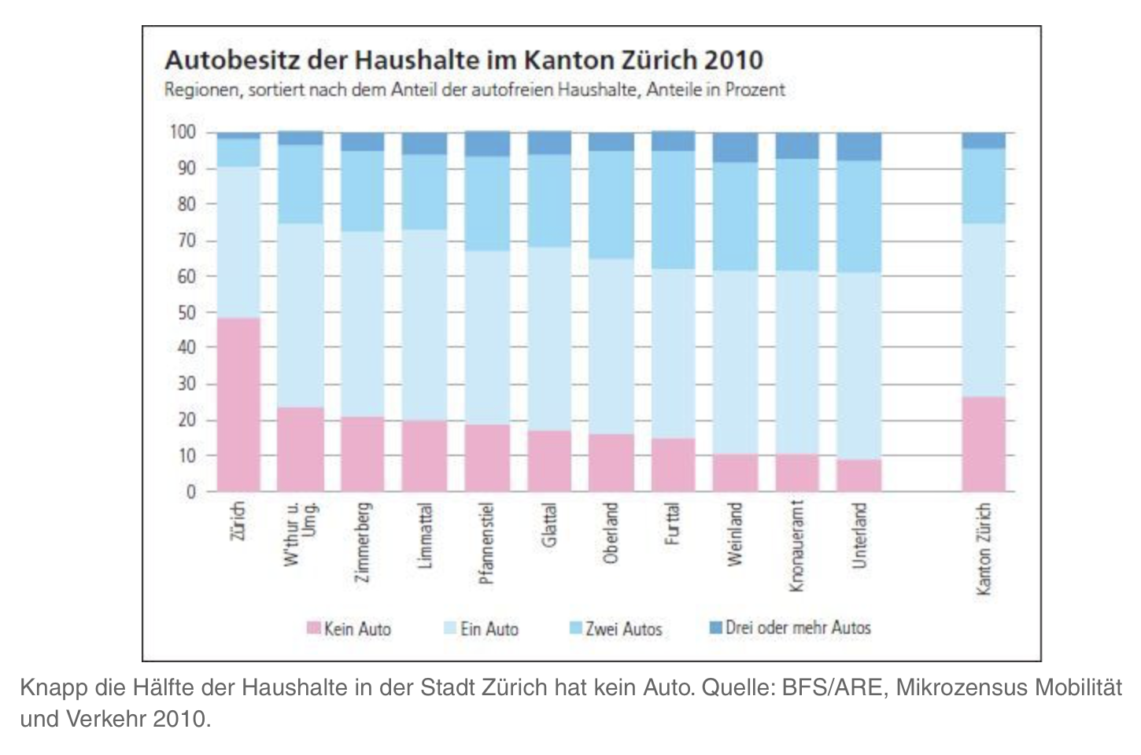

Slide 23
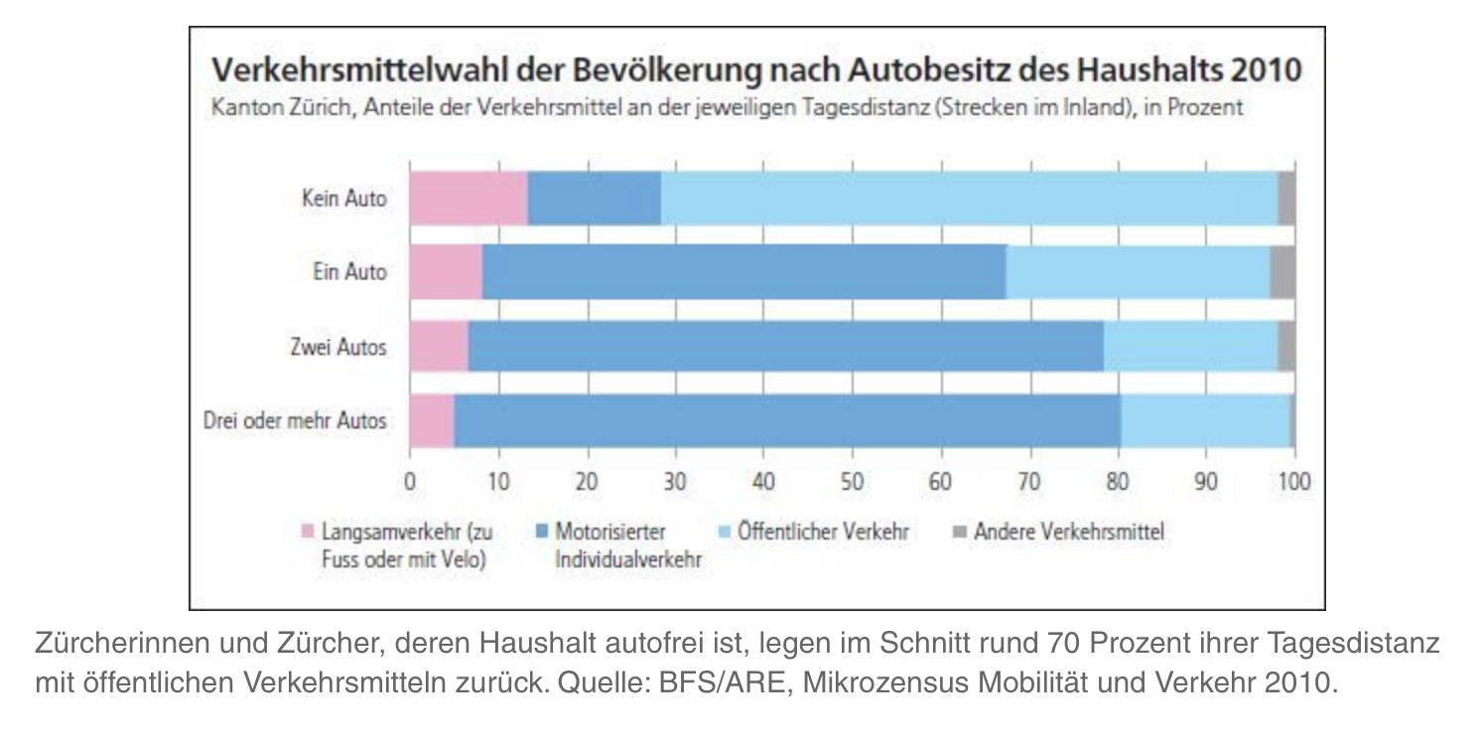

Slide 24
TARGET GROUPS
3 Main Target Groups
Families
Students
Businessman
Routinised schedule
Occasional usage
Frequent usage
Frequent usage
Long term planning
Urgent / Short term travel
Special Tools (chairs, etc)
Large cars / Transportation
Premium class cars
Preference over public transport
Price sensitive
Difficulty
Predictability

Slide 25
TARGET GROUPS
3 Main Target Groups
Families
Students
Businessman
Routinised schedule
Occasional usage
Frequent usage
Frequent usage
Long term planning
Urgent / Short term travel
Special Tools (chairs, etc)
Large cars / Transportation
Premium class cars
Preference over public transport
Price sensitive
Difficulty
Predictability

Slide 26
TARGET GROUPS
3 Main Target Groups
Families
Students
Businessmen
Routinised schedule
Occasional usage
Frequent usage
Frequent usage
Long term planning
Urgent / Short term travel
Special Tools (chairs, etc)
Large cars / Transportation
Premium class cars
Preference over public transport
Price sensitive
Difficulty
Predictability

Slide 27
SECOND
SOLUTION

Slide 28

Mock-up demo

Slide 29
THIRD
WHY IT WORKS?

Slide 30
Fertig
Pricing Model

Slide 31
Fertig
Call Volvo!

Slide 32
Q&A

Slide 33
FIRST
Machine Learning in a Nutshell

Slide 34
DT Data Science
A machine learning algorithm is an algorithm that is able to learn
from data:
“A computer program is said to learn from experience E with respect
to some class of tasks T and performance measure P , if its
performance at tasks in T, as measured by P, improves with
experience E .” [Mit97]
Three ingredients:
• Experience E: data
• Task T: forecasting, classification, clustering
• Performance P: measured using a cost or error function

Slide 35
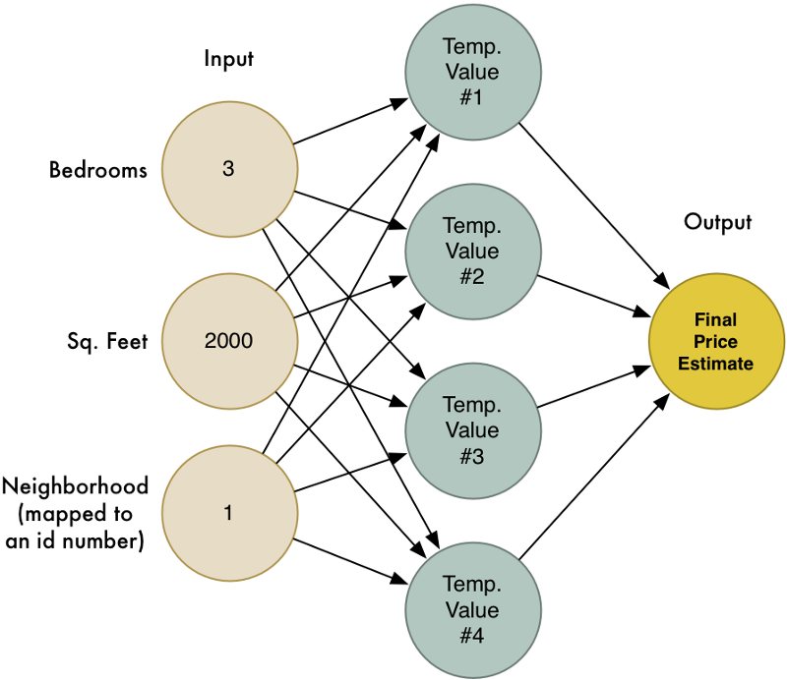
Weights - Memory of an Algorithm

Slide 36
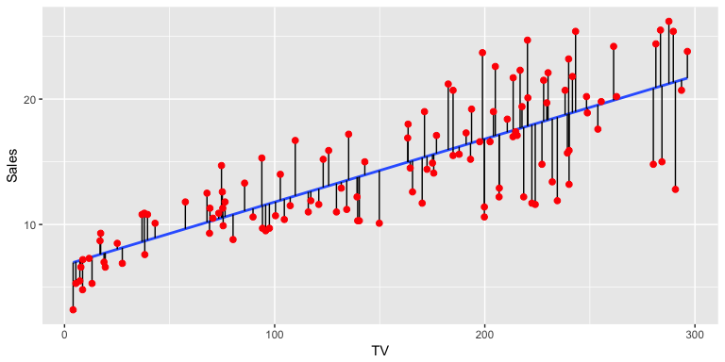
Prediction and Error

Slide 37
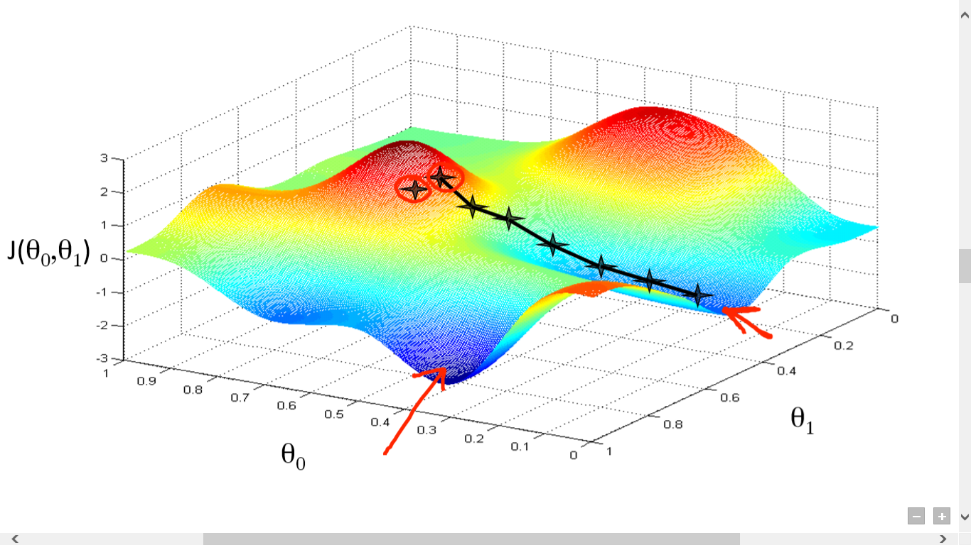
Cost Function - Gradient Descent
Notes:
Gradient descent is a first-order iterative optimization algorithm for finding the minimum of a function. To find a local minimum of a function using gradient descent, one takes steps proportional to the negative of the gradient (or approximate gradient) of the function at the current point.

Slide 38
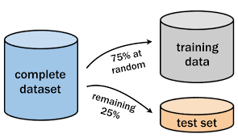
Test and Training Data

Slide 39
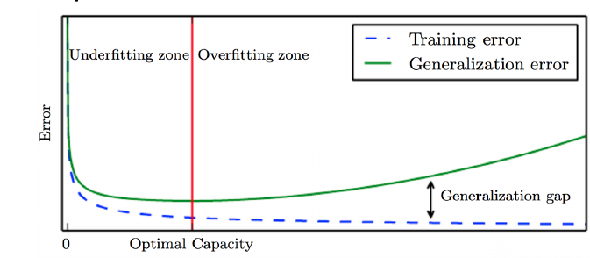

Slide 40
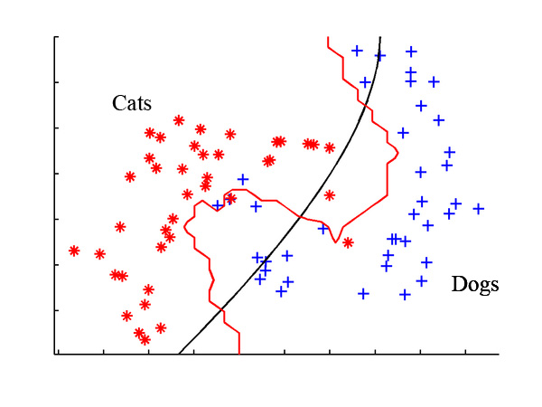

Classifier - Cats or Dogs
Labeled Data
Supervised Learning

Slide 41
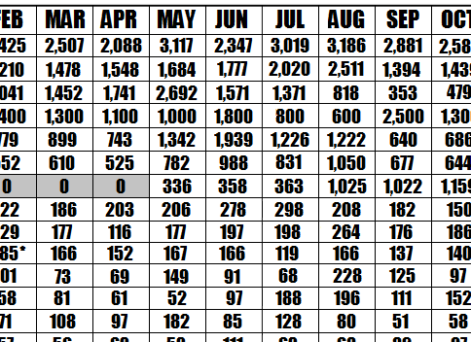
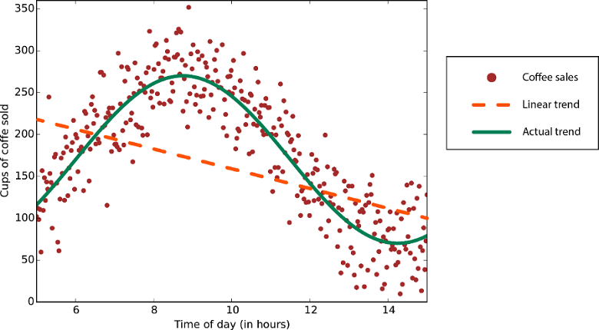
Prediction - Coffee Sales

Slide 42
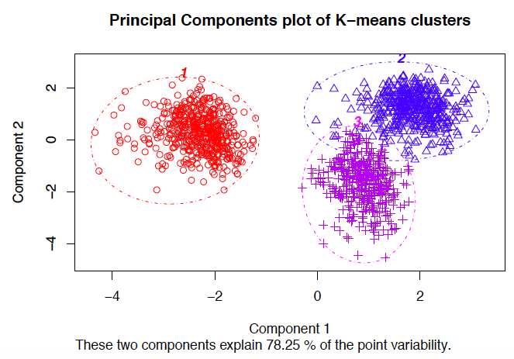
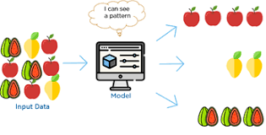
Clustering - Some Similarities
Unlabeled Data
Unsupervised Learning

Slide 43
FIRST
Common Use Cases

Slide 44
DT WEB DEVELOPMENT
Predicting the best retail location
Detecting Insurance Fraud
Recommender Systems (Spotify, Netflix, Instagram, Zalando)
Market Basket Analysis
Target - Pregnancy Prediction
Customer Sentiment Analysis

